Slide 1
Drones for Disaster Management
Aditya Shenoy – 161080036
Rahul Bhoir – 161080063
Kalyani Borkar – 171081990
Rani Deore – 171081993

Slide 2
Introduction

Slide 3
Natural Disaster
A disaster can be defined as any tragic event stemming from events such as earthquakes, floods, accidents, fires, or explosions
It causes damage to life and property and destroy the economic, social or cultural life of people

Slide 4
Drones
A drone (unmanned aerial vehicle) is an aircraft without a human pilot on board
Drones are used in applications where human presence is infeasible
Drones can be automated and intelligent by taking decisions depending on the situation

Slide 5
Why Drones in Disaster Mgmt?
Efficiency in emergency management
Early detection of disasters
Prevention of disasters

Slide 6
Drones for Optimized Earthquake Rescue

Slide 7
Top level steps of algorithm
Locate Earthquake
Classify Collapsed Buildings
Rescue Mission Planning

Slide 8
Locate Earthquake
Officials will report information about the earthquake
Find the affected area according to the earthquake source and intensity
Planning the optimized path for traversing all buildings in the affected area

Slide 9
Classify Collapsed Buildings
Take photograph of building from different angles
Pass the images and heat sensor data of the buildings to the Neural Network model
Neural Network will classify the building according to the predefined scales
Use heat sensors to detect people in buildings

Slide 10
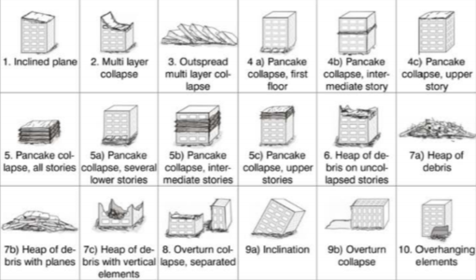
Earthquake Scales for Classification

Slide 11
Rescue Mission Planning
Send the map to the rescue team
Plan the rescue mission according to the classification of the buildings

Slide 12
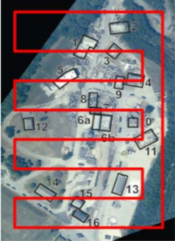
Example of Path Planning

Slide 13
Drones for Flood Prevention and Rescue Planning

Slide 14
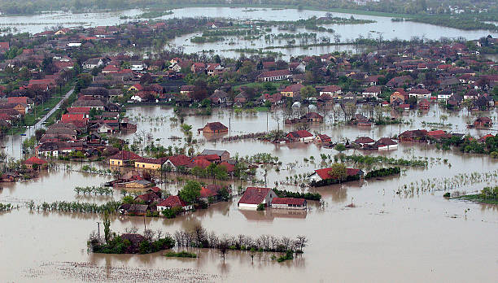
Drones at Start

Slide 15
Top level steps of algorithm
Capture images of areas near dam
Predict direction of dam overflow
Decide the rescue plan

Slide 16
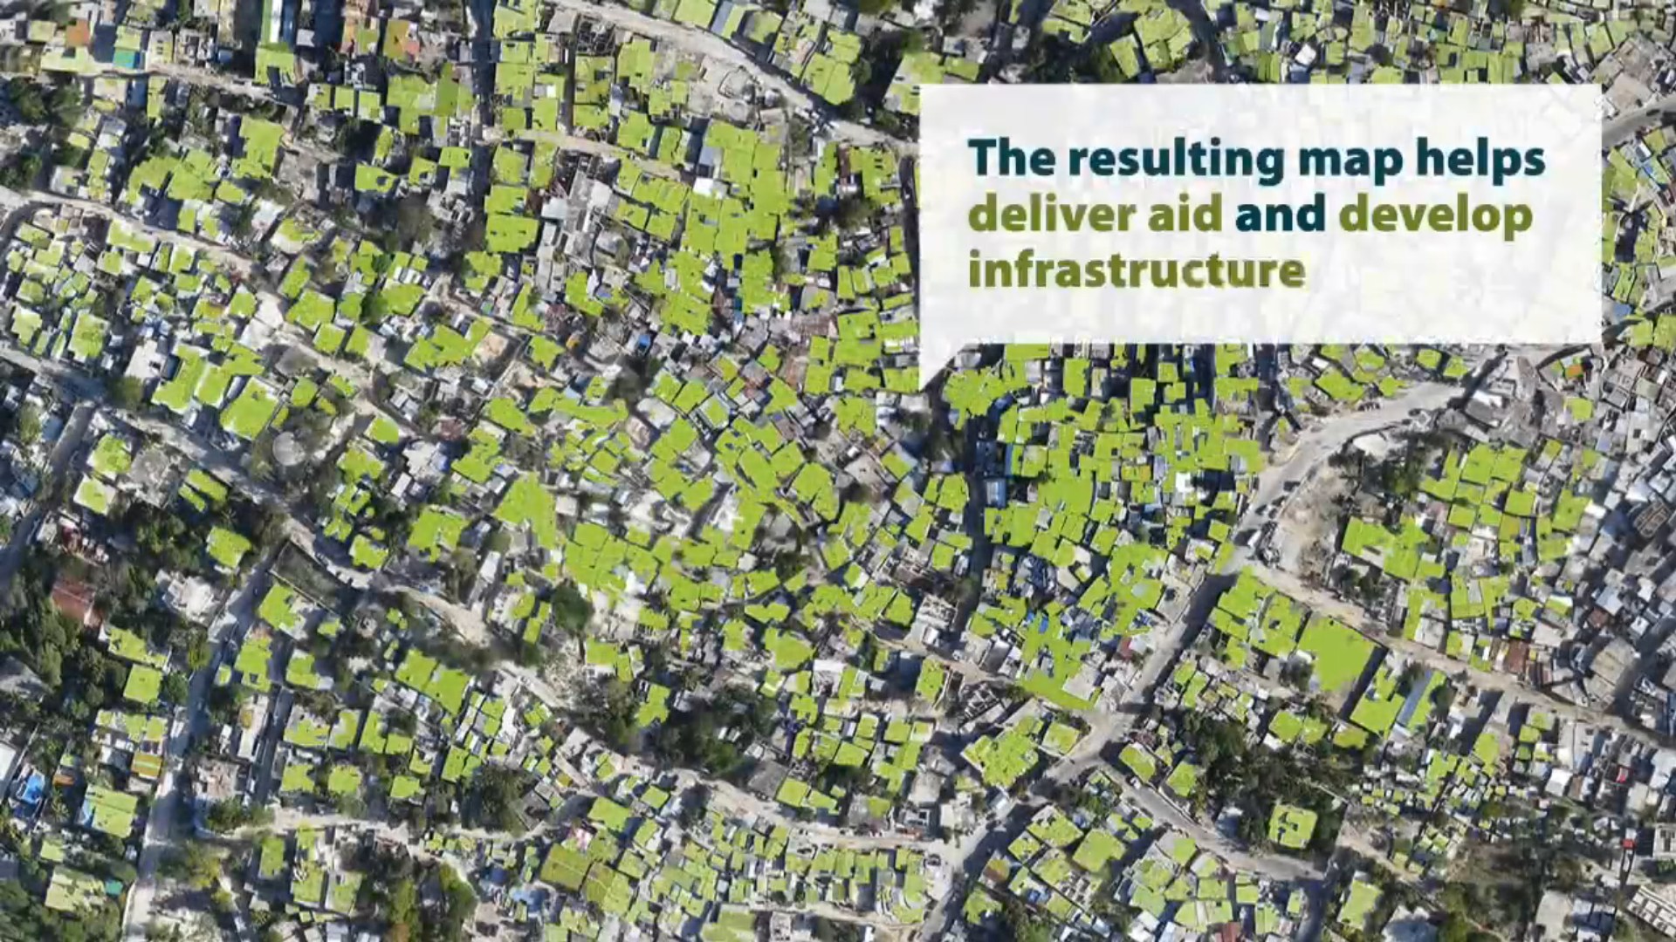
Capture Images near Dam

Slide 17
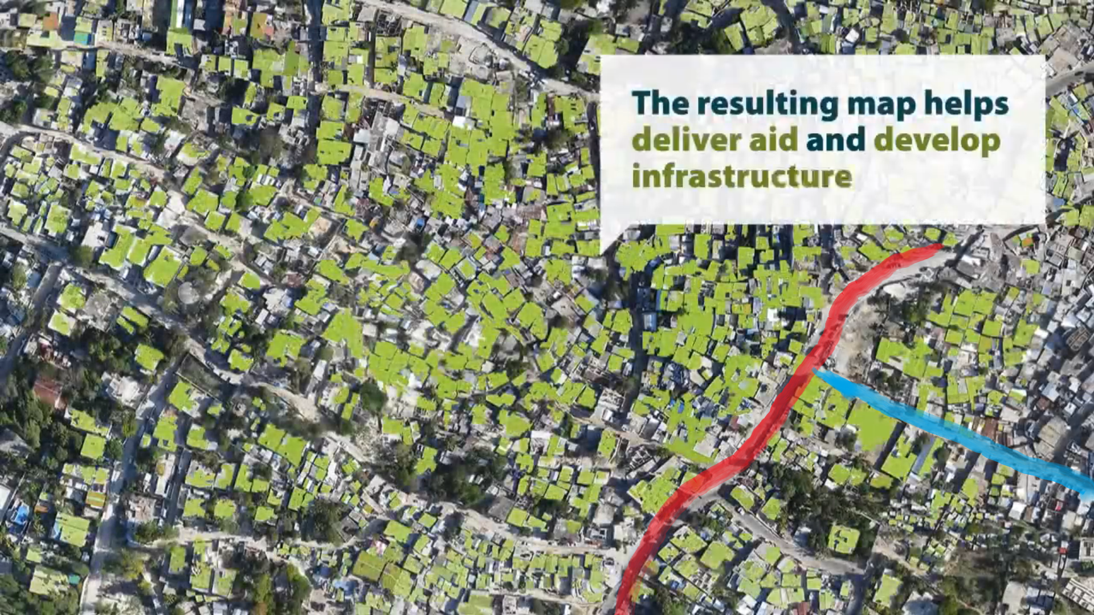
Predict Direction of Dam Overflow

Slide 18
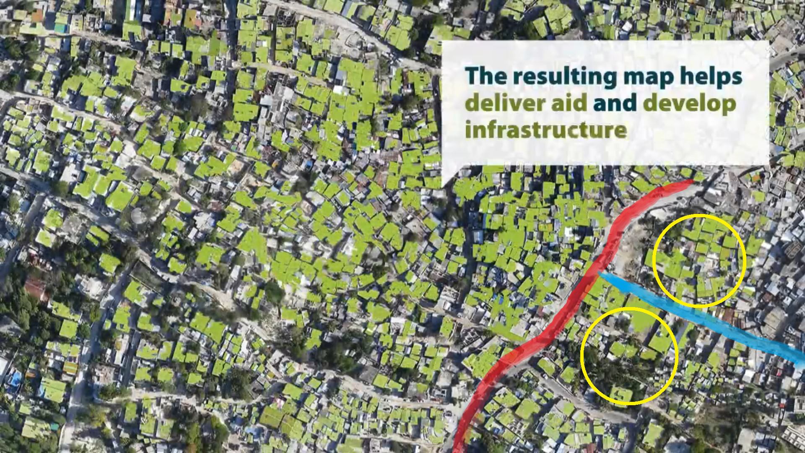
Decide the Rescue Plan

Slide 19
Drones for Forest Fire Detection

Slide 20
Top level steps of algorithm
Continuous patrolling over the forest
Detect hotspot by smoke image
Follow the smoke and take photograph of the source

Slide 21
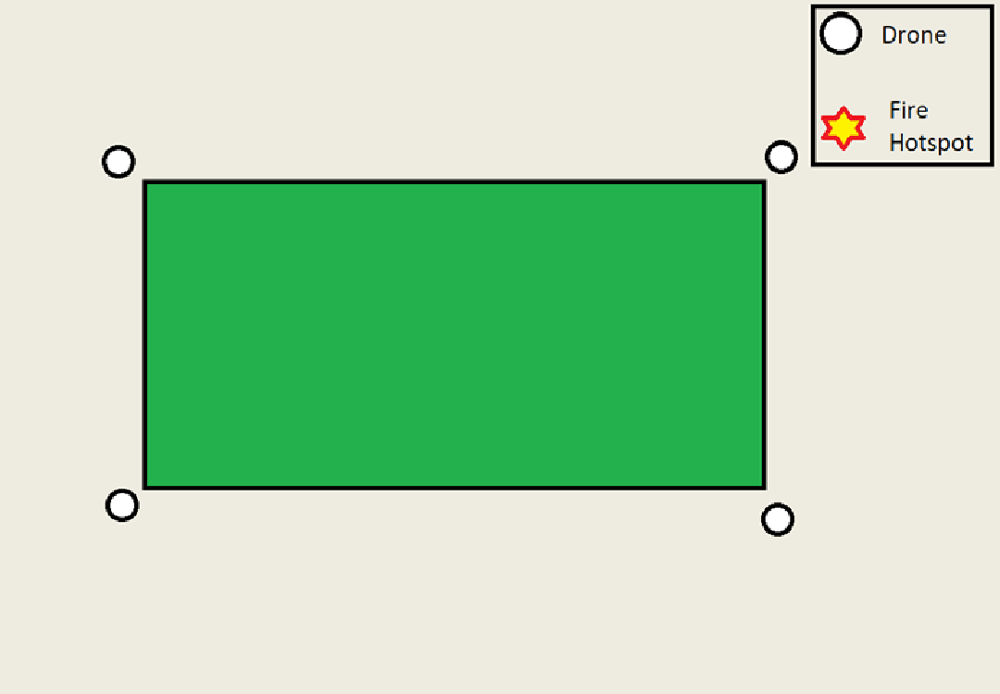
Drones at Start

Slide 22
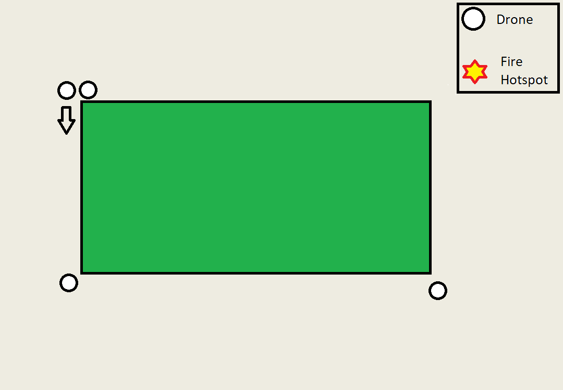
Continuous Patrolling over Forest

Slide 23
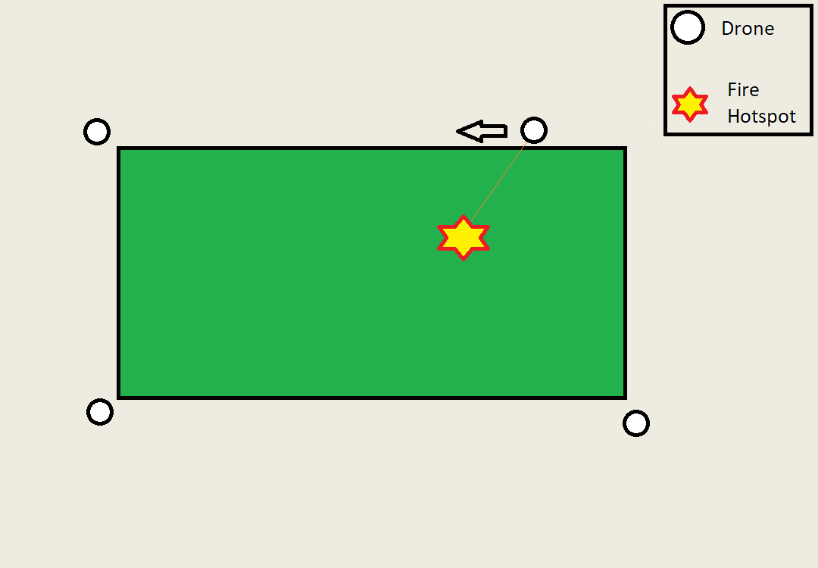
Detect Hotspot by Smoke Image

Slide 24
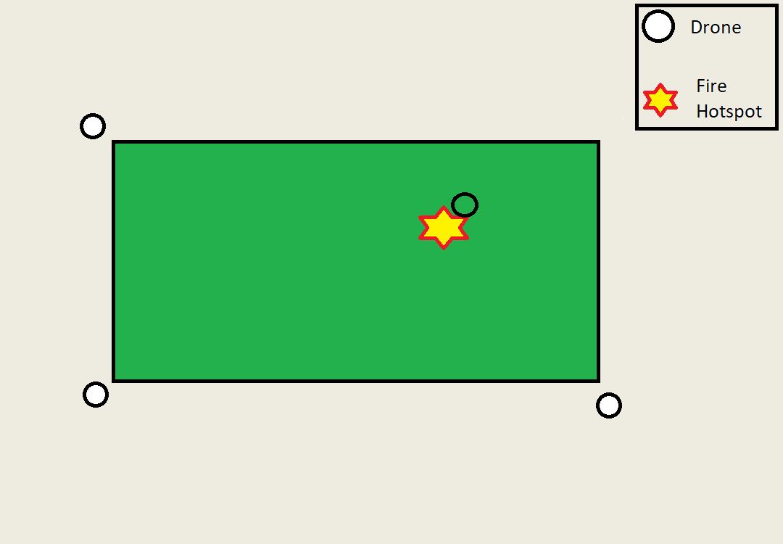
Follow Smoke and Take Photograph

Slide 25
References
http://dx.doi.org/10.4236/wjet.2015.33C047
https://www.wikipedia.com

Slide 26
Thank You

